Slide 1

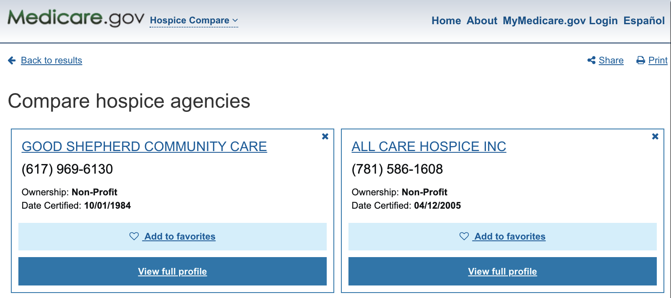
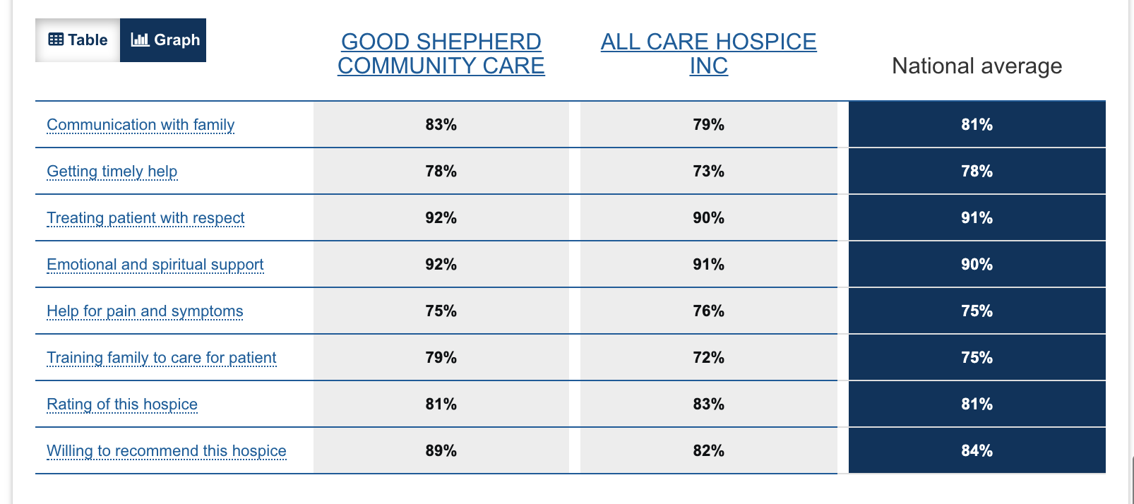
CAHPS
PUF
Provider
Data
Senti-Mentor
What predicts satisfaction?

